Slide 1
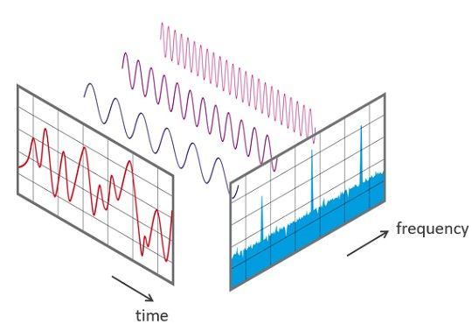
How-to Implement a DFT on a Real-Time System
Rainer Nitsche – 02/2024
Discrete Fourier Transform – DFT

Slide 2
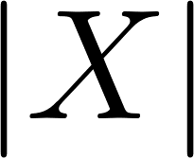
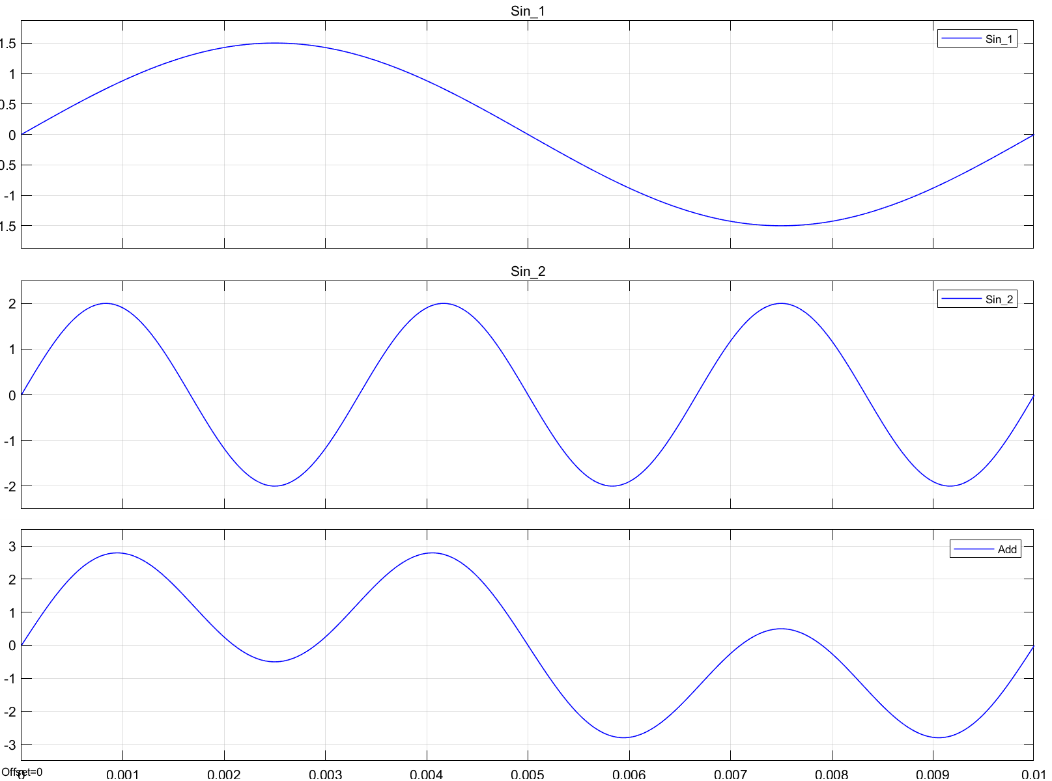
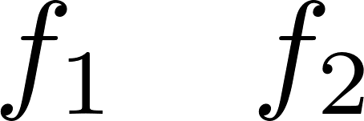
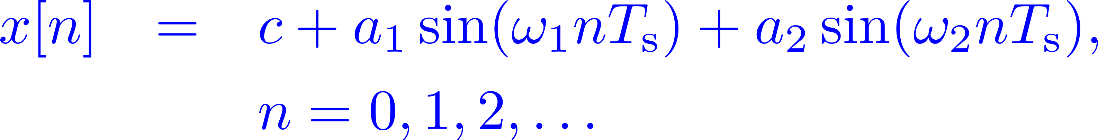
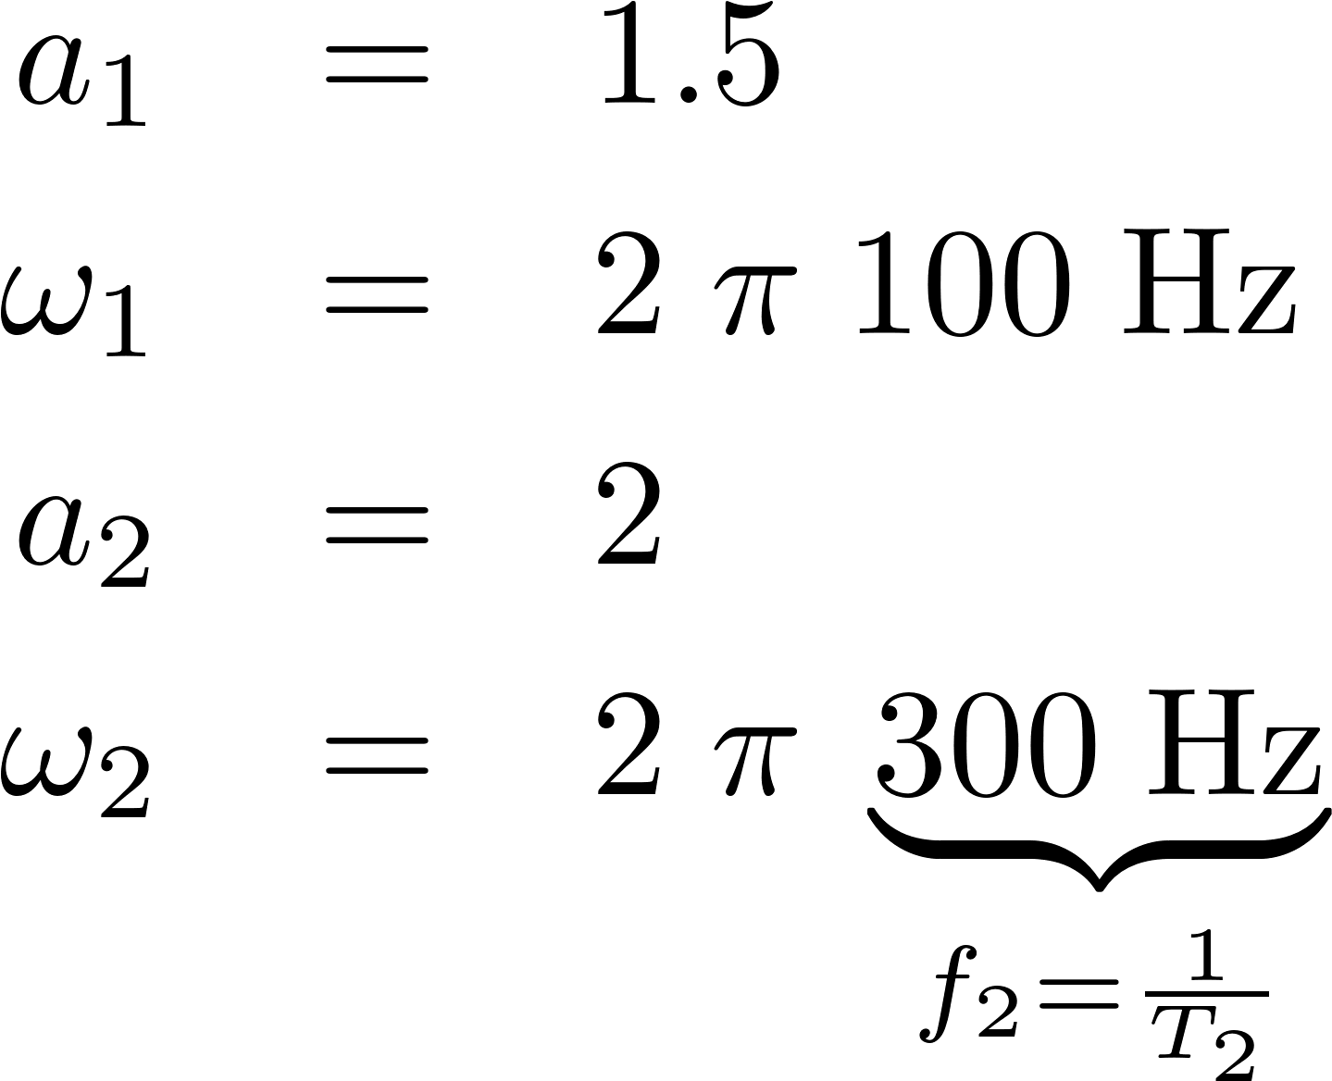
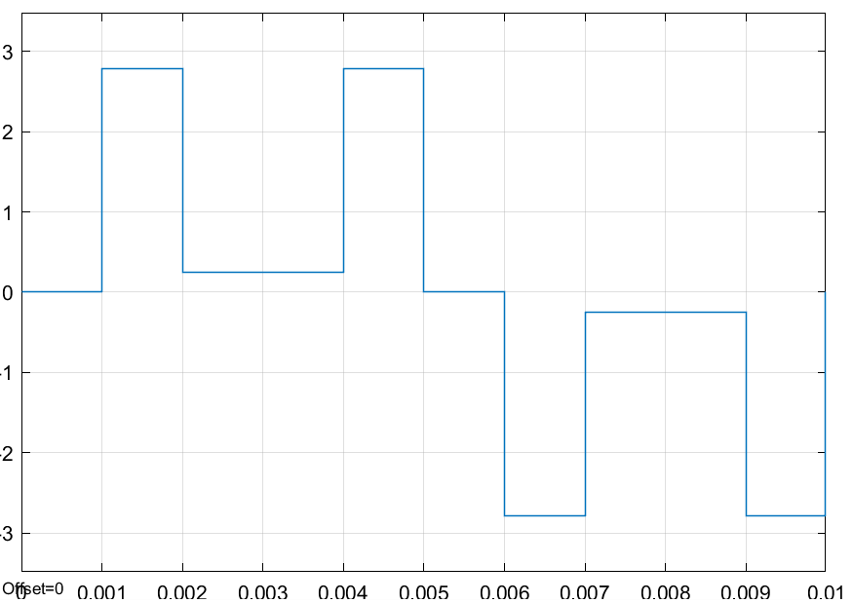
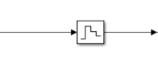
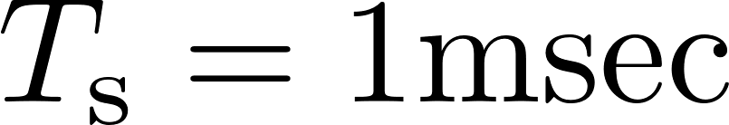
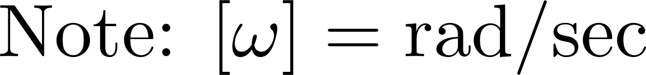
FFT/DFT in Real-Time | Objectives
Analyzing a time domain signal in the frequency domain ⇝ Fourier Transform
The fast Fourier transform (FFT) is an efficient method to compute a discrete Fourier transform (DFT)
Example
f
FFT DFT
Parameters:
Time ->

Slide 3
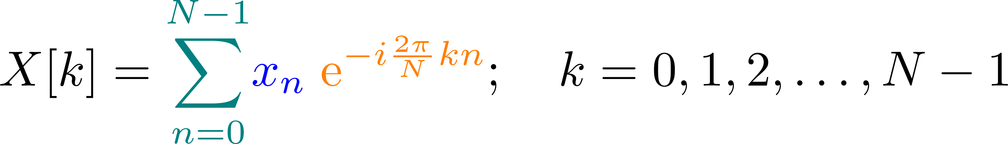



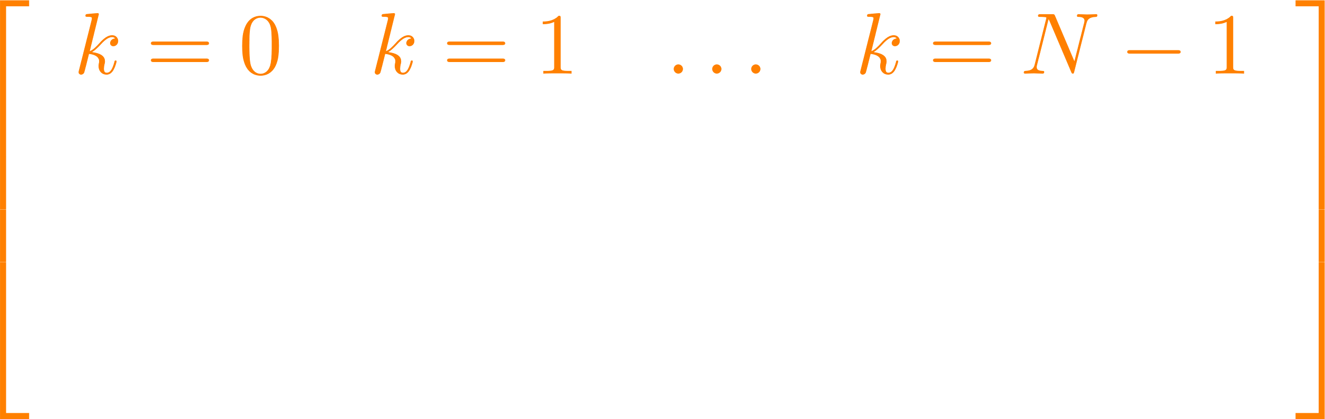
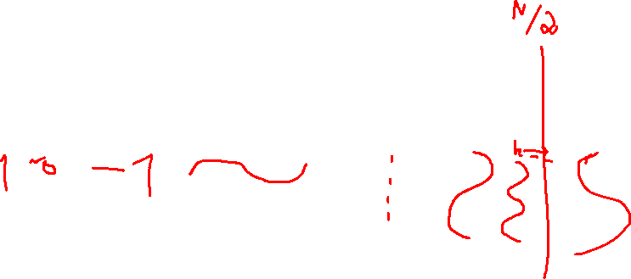
FFT/DFT in Real-Time | Discrete Fourier Transform (DFT)
Multiplication with sines and cosines of different frequencies
N: number of samples
Discrete-time signal
DFT: Matrix Multiplication
positive
negative
0 1 2 . . .
N-1
k
See also: https://www.youtube.com/watch?v=QmgJmh2I3Fw
Notes:
https://www.overleaf.com/learn/latex/Using_colors_in_LaTeX
Skalarprodukt oder inneres Produkt von xn mit der k-ten Spalte…
Für große N wird die Multiplikation sehr aufwändig -> FFT
k: Frequenz
n: sample Point -> time
X[k]: correlating signal

Slide 4
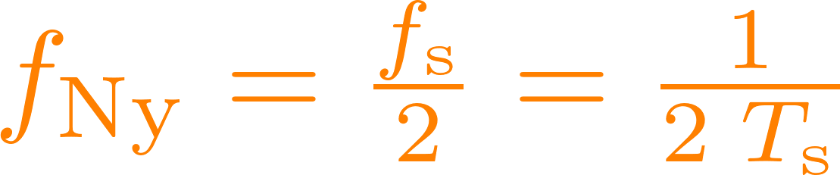
FFT in Real-Time | Practical Issues: one- / two-sided FFT
One-sided and two-sided FFT
Nyquist frequency:
positive
negative
K=0
Nyquist frequency
K=N-1
Notes:
Positive and negative Frequenzen in der FFT

Slide 5
FFT in Real-Time | Practical Issues: one- / two-sided FFT
One-sided and two-sided FFT
positive
negative
K=0
Nyquist frequency
K=N-1
Notes:
Positive and negative Frequenzen in der FFT

Slide 6
FFT in Real-Time | Practical Issues: one- / two-sided FFT
One-sided and two-sided FFT
two-sided
negative
positive
K=0
Nyquist frequency
Notes:
Positive and negative Frequenzen in der FFT

Slide 7
FFT in Real-Time | Practical Issues: one- / two-sided FFT
One-sided and two-sided FFT
Nyquist frequency:
one-sided
Nyquist frequency is the highest frequency which can be measured / detected in the
sampled data
positive
Offset/Bias: k=0
positive
negative
0 1 2 . . .
N-1
k
K=0
Nyquist frequency
Nyquist-Frequency: k=N/2
Notes:
Positive and negative Frequenzen in der FFT

Slide 8



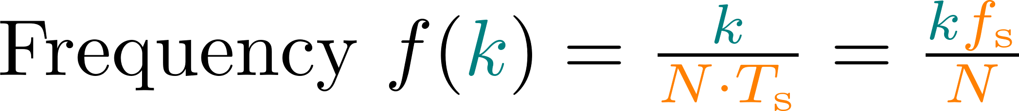
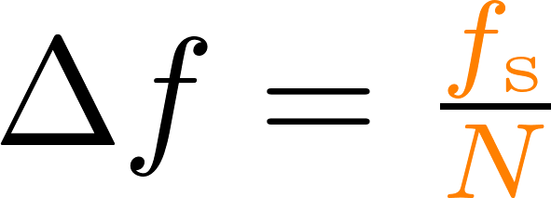
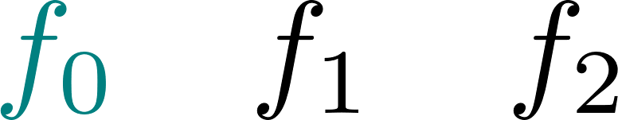
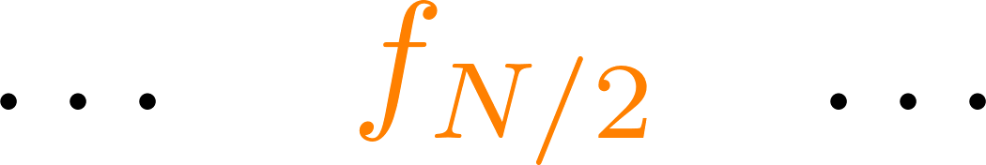
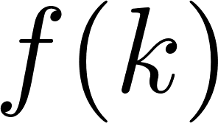
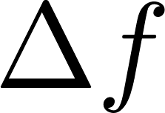
FFT in Real-Time | Practical Issues: Frequency Resolution
Length of the signal
Length of the signal
Length of the signal
Length of the signal
0 1 2 . . .
N-1
k
Bin width:
Resolution
Notes:
Length of the times signal: N Ts = N/Fs
T_1 = N Ts
T_2 = ½ T_1 = ½ N Ts
T_k = 1/k N Ts
Oder Kehrwert -> Frequenzen: f_k = k/N fs = k fs/N

Slide 9
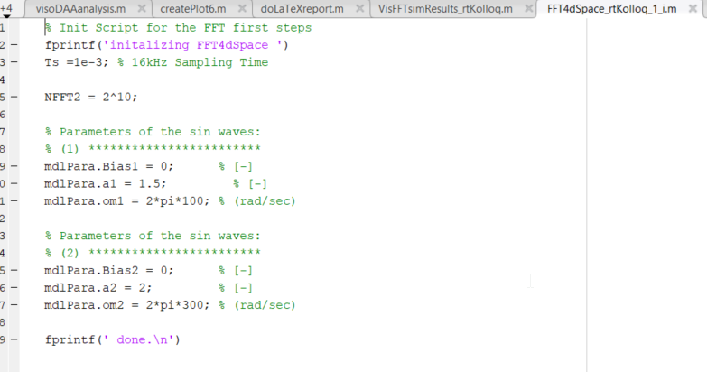
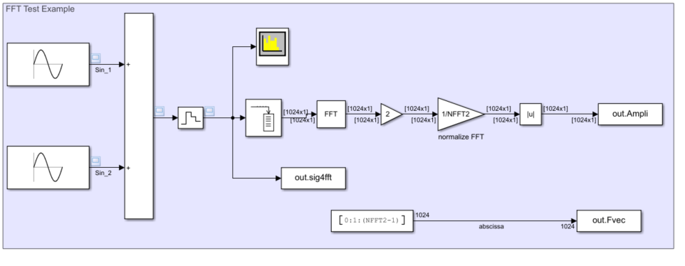
FFT in Real-Time | Simulink Example
Notes:
c:\workspace\teachingSMC\FFT\Matlab\FFT4dSpace_rtKolloq_1.slx

Slide 10
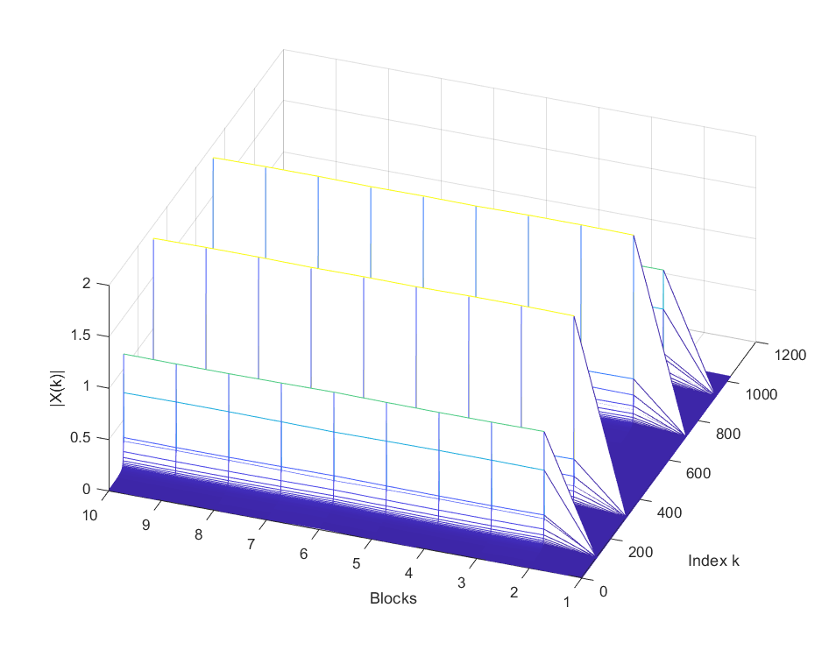
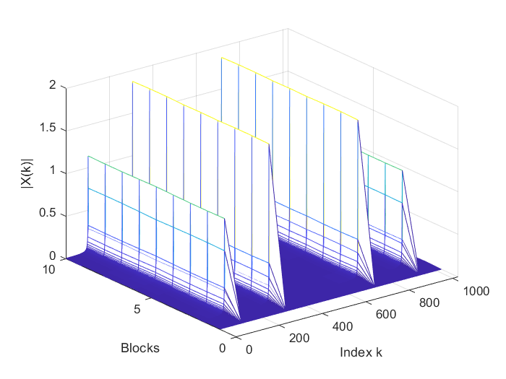
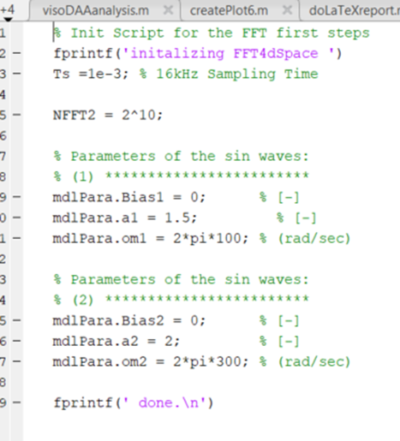
FFT in Real-Time | Simulink Example - Results
Nyquist frequency
Ts = 1msec t_sim = 10 sec
Notes:
~10 Runs: Simzeit = 10sec, 2^10 N à 1msec = 1Run takes ~1sec

Slide 11

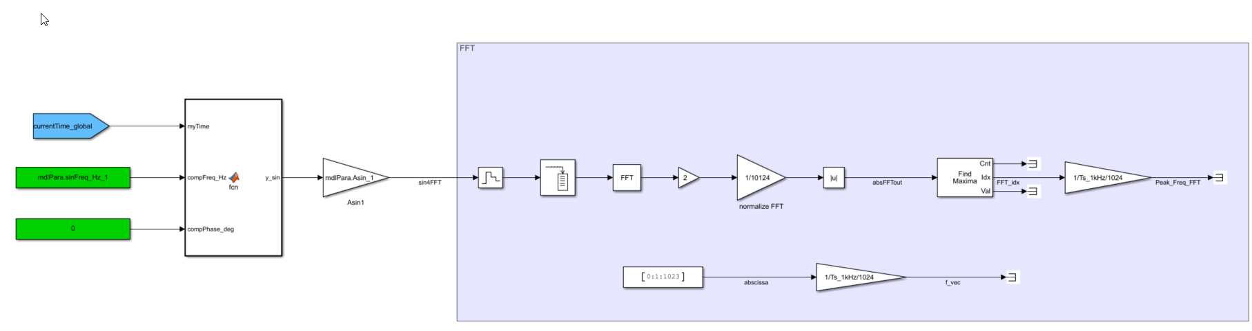
FFT in Real-Time | dSpace Example
Mdl: FFT4dSpace_1.slx
path: C:\workspace\teachingSMC\FFT\dSpace\SCALEXIO
Normalization of the amplitudes: - 1/N_samples - times 2: considering only half of the spectrum
⇝ 1/(N_samples /2)
Notes:
C:\workspace\teachingSMC\FFT\dSpace\SCALEXIO

Slide 12
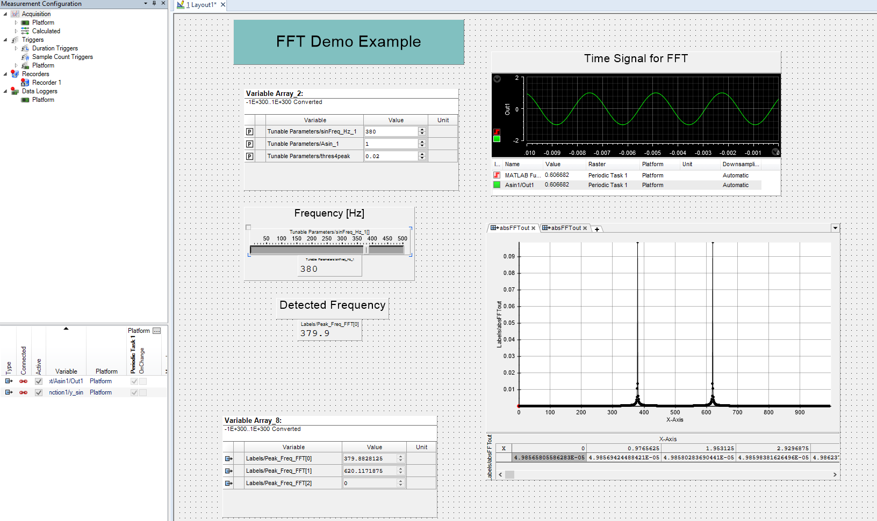
FFT in Real-Time | dSpace Example
Mdl: FFT4dSpace_1.slx
path: C:\workspace\teachingSMC\FFT\dSpace\SCALEXIO
Notes:
C:\workspace\teachingSMC\FFT\dSpace\SCALEXIO

Slide 13
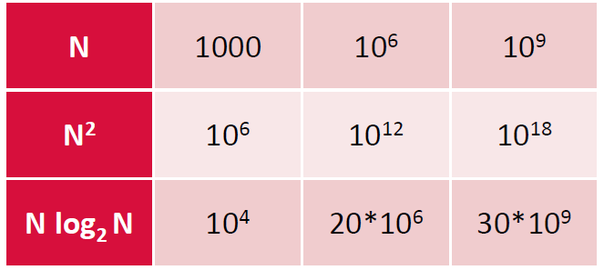
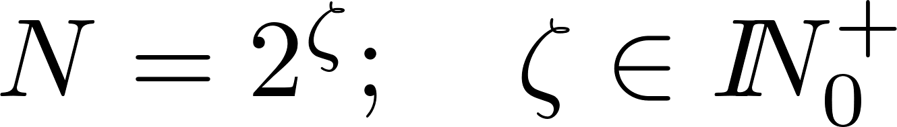
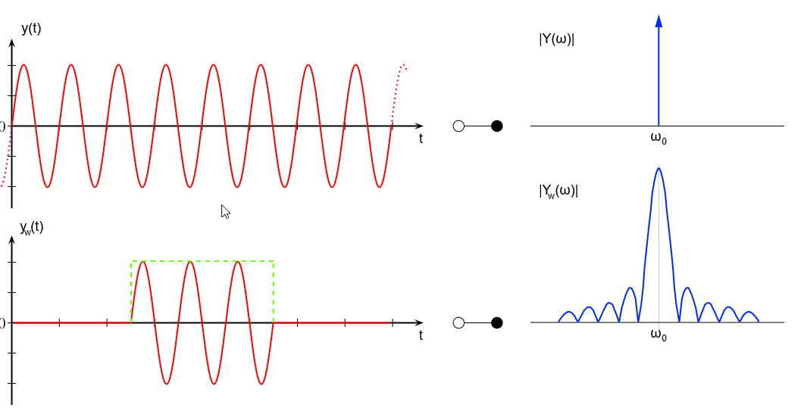
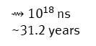
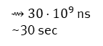
FFT in Real-Time | Summary
Calculation Effort DFT / FFT
Analyzing a time domain signal in the frequency domain ⇝ Fourier Transform
The fast Fourier transform (FFT) is an efficient method to compute a discrete Fourier transform (DFT)
Nyquist frequency (highest frequency to be detected):
Frequency resolution (bin width):
One-sided FFT is sufficient if one is only interested in the identifying the frequencies
Use even number of samples N to have a clear Nyquist frequency:
Note considered here:
Leackage effect due to finite samples
Only one DSP Signal Processing License@Festo !
DFT
⇝ ${10}^{18}$ ns ~31.2 years
FFT
⇝ ${30⋅10}^{9}$ ns ~30 sec
0 1 2 . . .
N-1
k
Quelle: https://de.wikipedia.org/wiki/Leck-Effekt (09.02.2024)

Slide 14
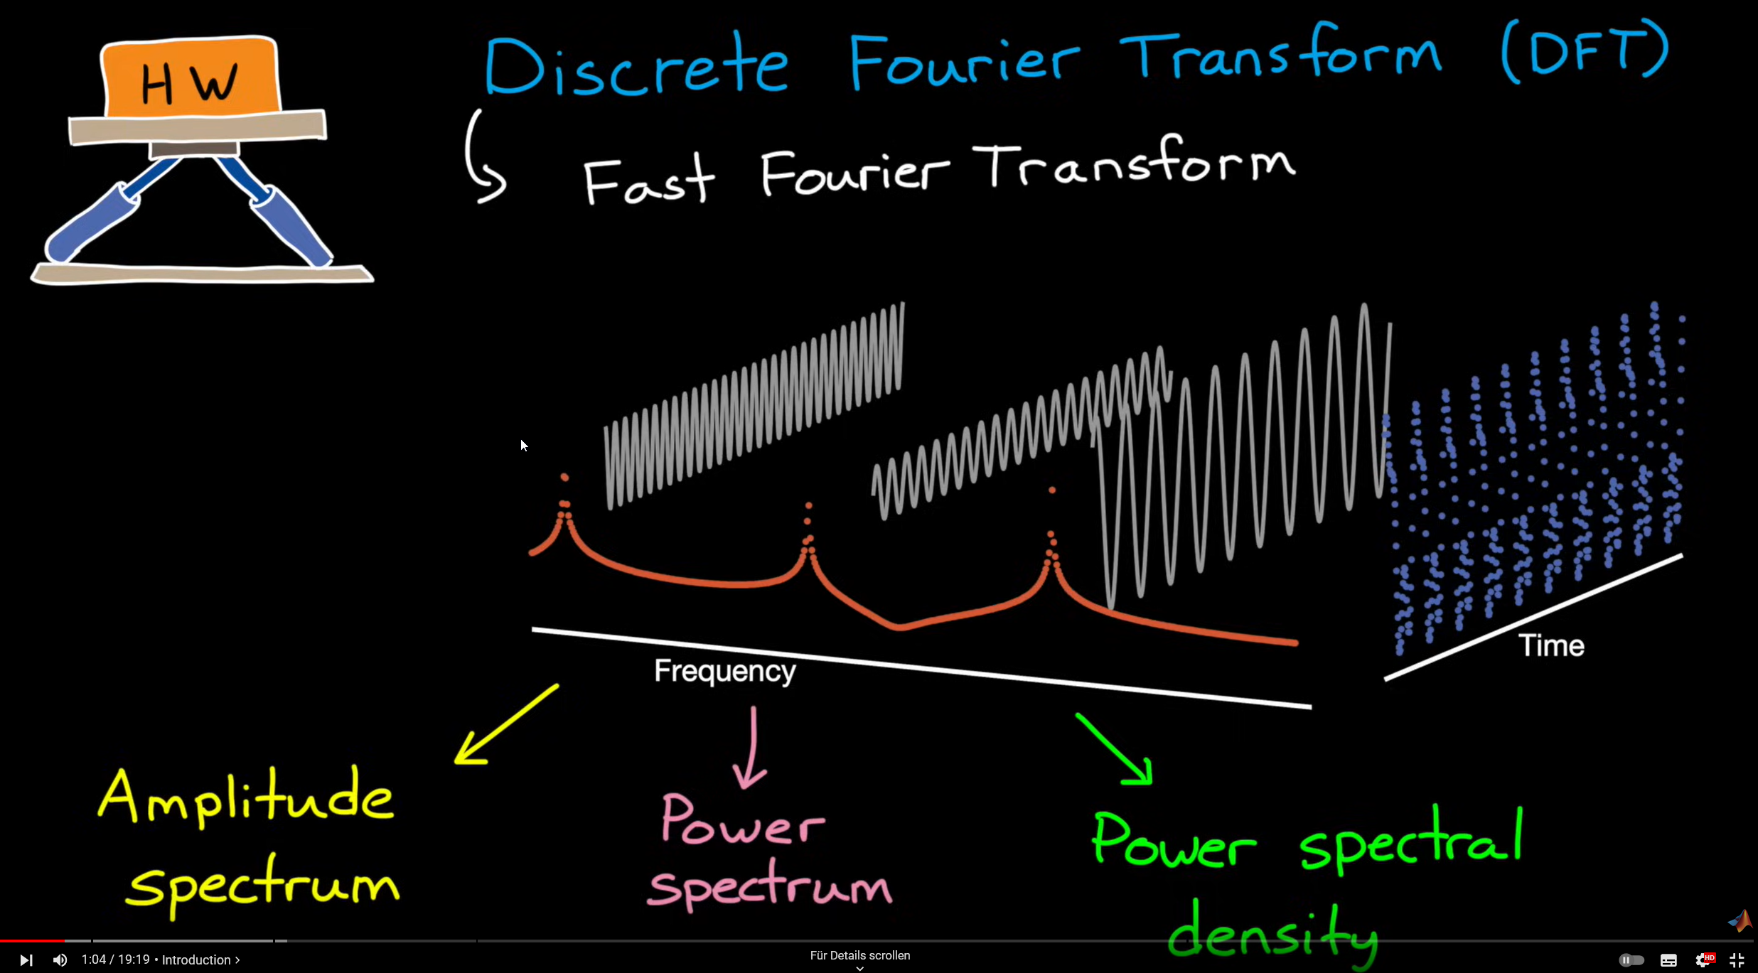
FFT in Real-Time | Helpful Links
Eigensteve
SteveBrunton_DFT
Matlab Tech Talks: Brian Douglas
BrianDouglasMatlabTechTalk
How-to: FFT in a dSpace environment
dSpace: FFT with ControlDesk
Notes:
Steve Brunton University of Washington (Mechanical Engineering)

Slide 16
FFT in Real-Time
Link to video: Steve Brunton / Matlab
Simulink Implementation
Plotting resutls from simulation and data capture…
How to chose:
Sample Time Ts
Number of samples for FFT : 2^N
Bin Width (Frequenzauflösung)
Nyquist Frequency
Leackage effect
ToDos: 09.02.2024
- Bilder für ein/zwei seitiges Spektrum besser ausrichten…

Slide 18
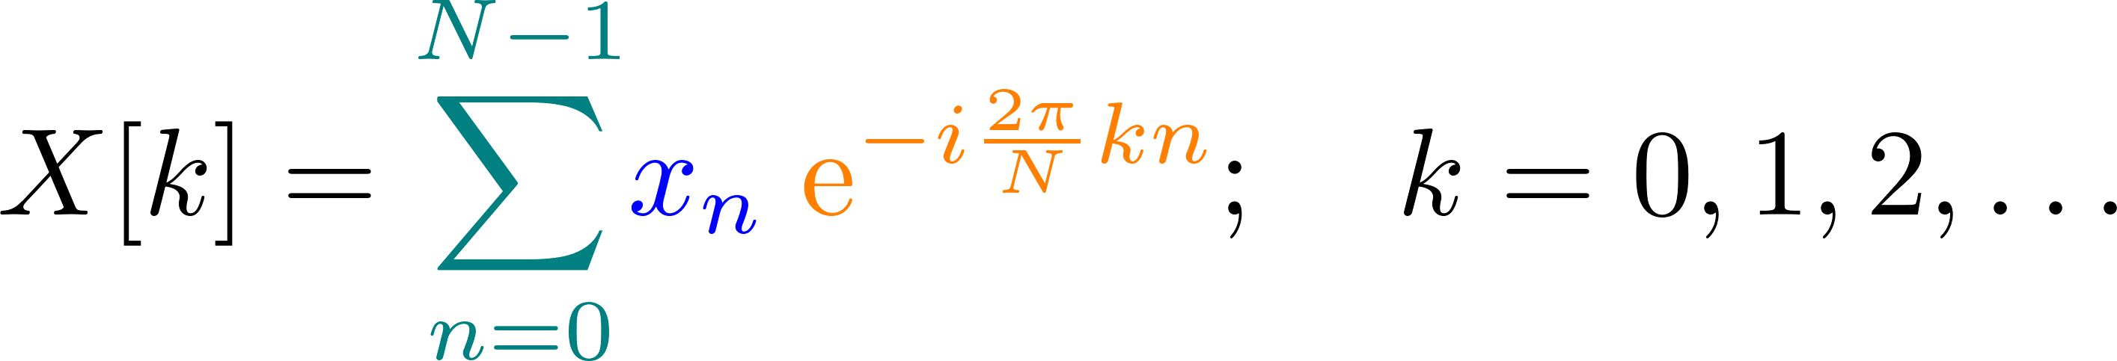
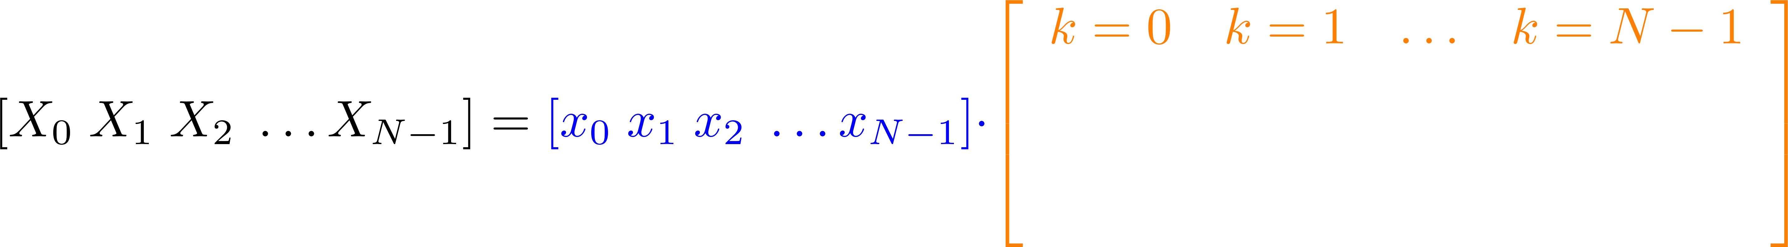
FFT in Real-Time | Discrete Fourier Transform (DFT)
We are creating sines and cosines of different frequencies
Discrete-time signal
https://www.youtube.com/watch?v=QmgJmh2I3Fw
Notes:
https://www.overleaf.com/learn/latex/Using_colors_in_LaTeX
Skalarprodukt oder inneres Produkt von xn mit der k-ten Spalte…

Slide 19
FFT in Real-Time | Practical Issues: one- / two-sided FFT
One-sided and two-sided FFT
Nyquist frequency:
One-sided
Nyquist frequency is the highest frequency which can be measured / detected in the
sampled data
positive
Offset/Bias: k=0
positive
negative
0 1 2 . . .
N-1
k
K=0
Nyquist frequency
Nyquist-Frequency: k=N/2
Notes:
Nyquist Frequenz ist die höchste Frequenz die durch die FFT ermittelt werden kann

Slide 20
